Slide 1
Android Application based Home Automation System
Priyanka Salvi (917163772)

Slide 2
INTRODUCTION
Home Automation has been used to introduce the concept of networking appliances and devices in the house.
To control household appliances like light, door, fan, AC etc.
Provides home security and emergency system.

Slide 3
OBJECTIVES
To control appliances through android phone
To control the intensity of the appliances using Dimmer circuit.
To help handicapped and old aged people who will enable them to control home appliances and alert them in critical situations.

Slide 4
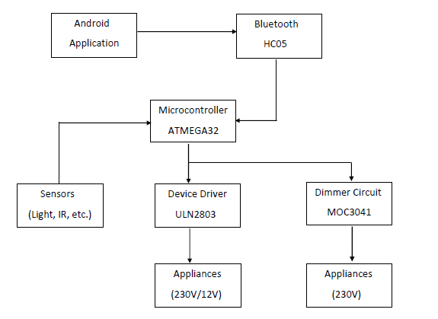
BLOCK DIAGRAM

Slide 5
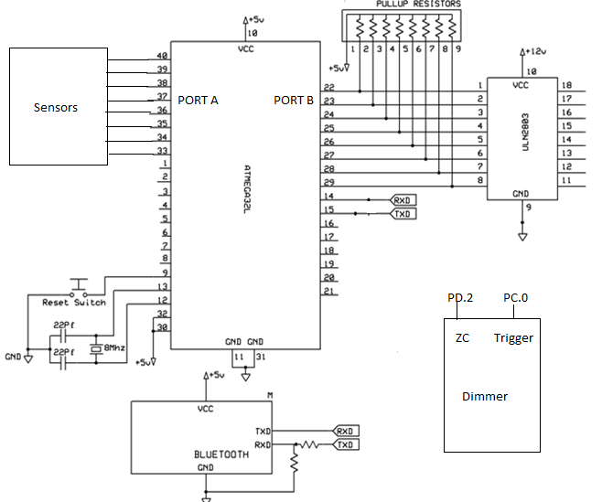
CIRCUIT DIAGRAM

Slide 6
SENSORS
Temperature sensor
Light sensor
IR sensor for intrusion detection
Level sensor

Slide 7

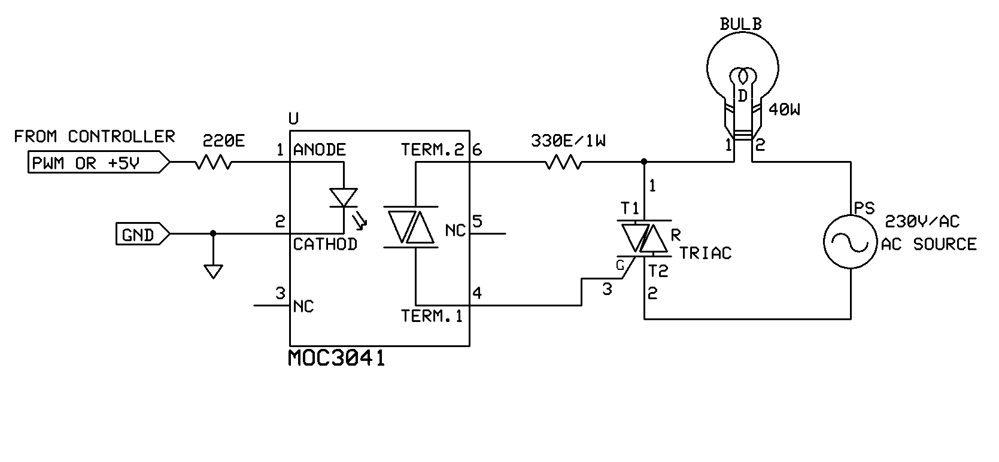
DIMMER CIRCUIT

Slide 8
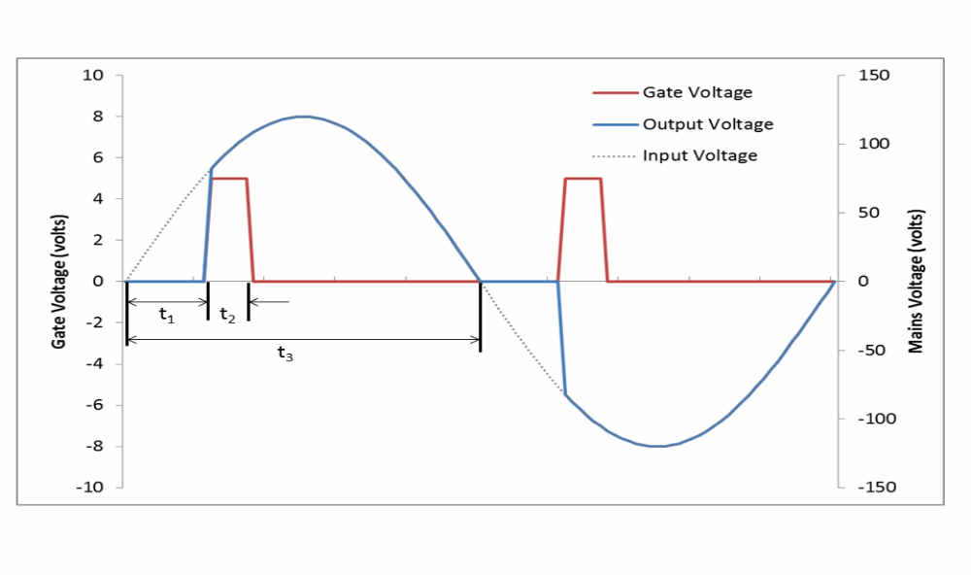
PWM WAVEFORM

Slide 9
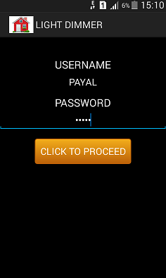
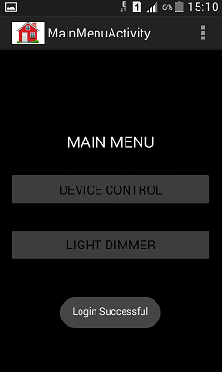
SCREENSHOTS

Slide 10
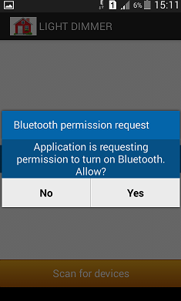
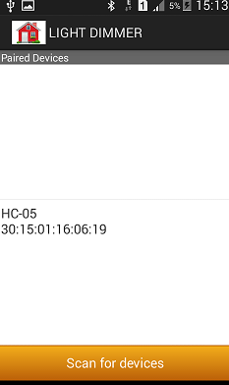

Slide 11
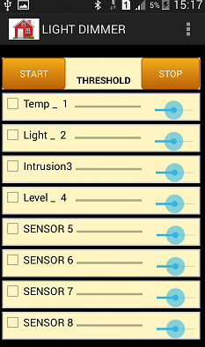
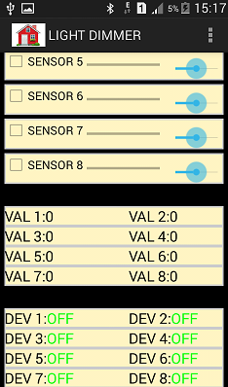

Slide 12
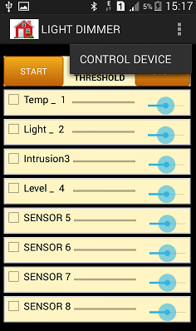
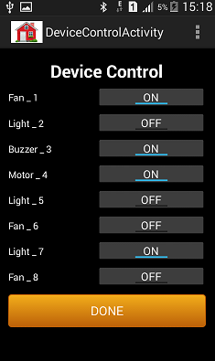

Slide 13
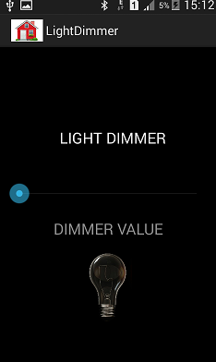
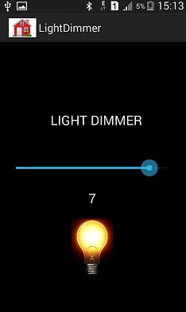

Slide 14
ADVANTAGES
Appliances of 230V and 12V can be controlled
Minimum 8 appliances can be connected
Intensity of 230V appliances can be varied
Status of the Appliances can be changed Manually or through Automode

Slide 15
FUTURE SCOPE
The range can be increased by using internet instead of Bluetooth.
Can also be used in fields like industries, medical, commercial, etc.
Voice processing
Image processing

Slide 16
THANK YOU…!!!

